Slide 1
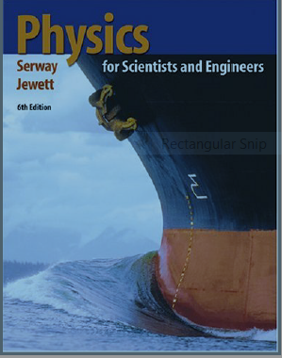
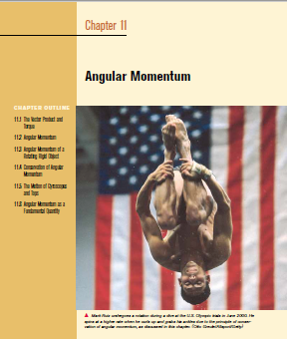
The Angular Momentum ( A/Prof Syed Hussain Shah)

Slide 2
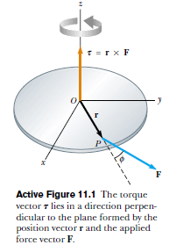
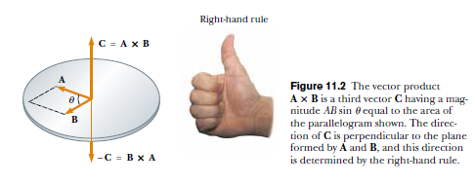
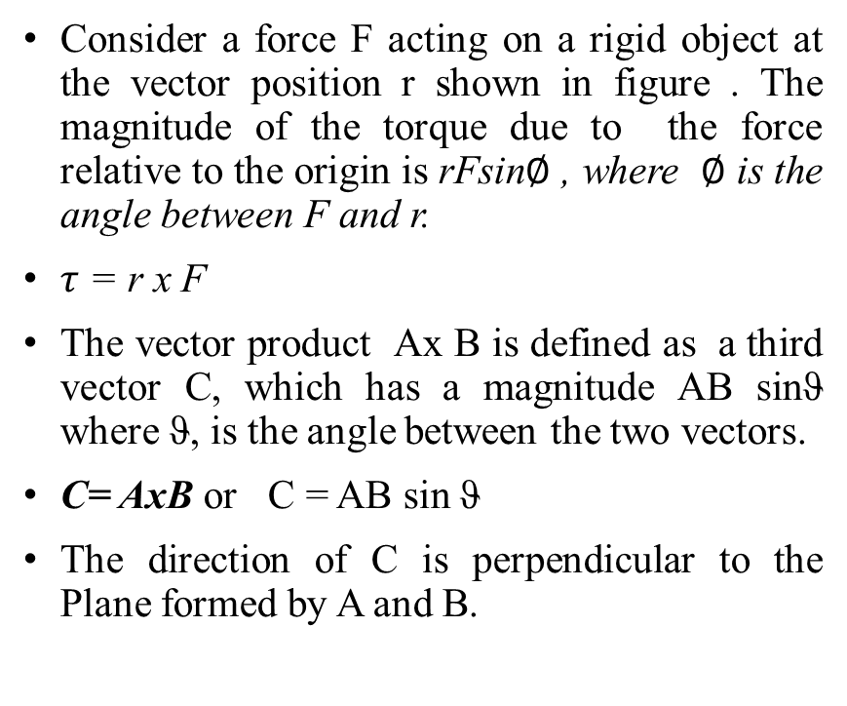
The Vector Product and Torque
Consider a force F acting on a rigid object at the vector position r shown in figure . The magnitude of the torque due to the force relative to the origin is rFsin$∅$ , where $∅$ is the angle between F and r.
$τ$ = r x F
The vector product Ax B is defined as a third vector C, which has a magnitude AB sinϑ where ϑ, is the angle between the two vectors.
C= AxB or C = AB sin ϑ
The direction of C is perpendicular to the Plane formed by A and B.

Slide 3
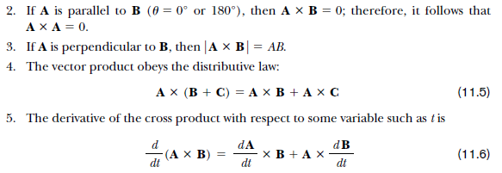
Important Properties of Vector Product
The vector Product is not Commutative i. e AxB = - (BxA)

Slide 4
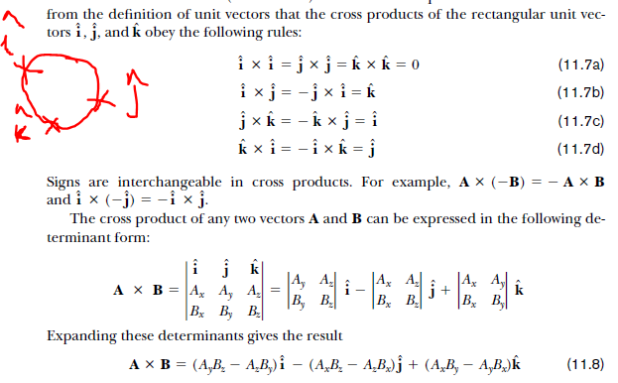

Slide 5
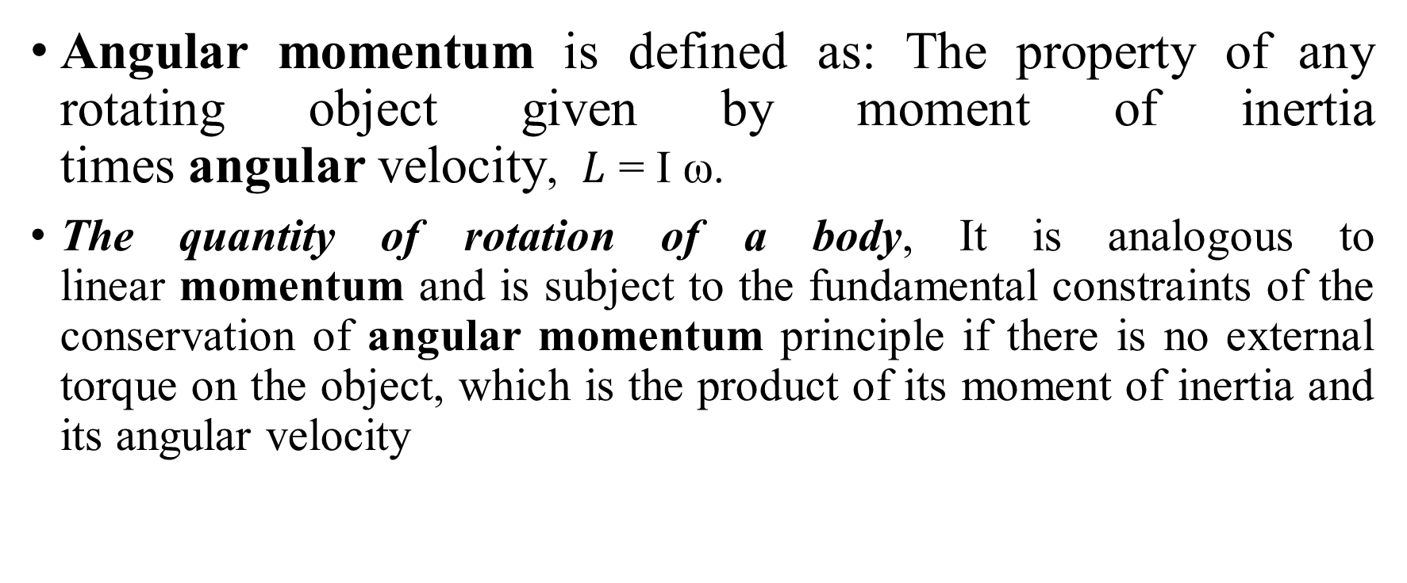
Angular Momentum
Angular momentum is defined as: The property of any rotating object given by moment of inertia times angular velocity, $L$ = I ω.
The quantity of rotation of a body, It is analogous to linear momentum and is subject to the fundamental constraints of the conservation of angular momentum principle if there is no external torque on the object, which is the product of its moment of inertia and its angular velocity

Slide 6
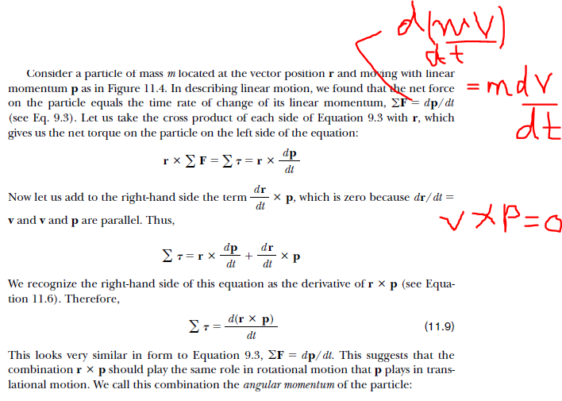
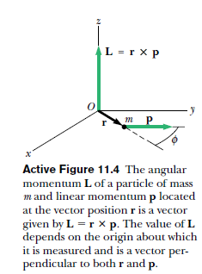

Slide 7
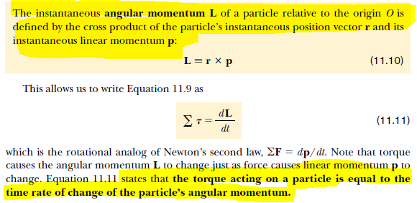

Slide 8
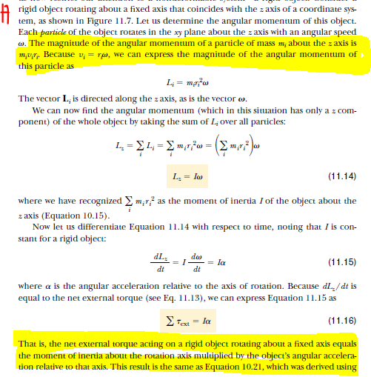
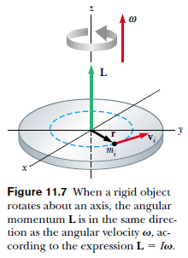
Angular Momentum of a Rotating Rigid Object

Slide 9
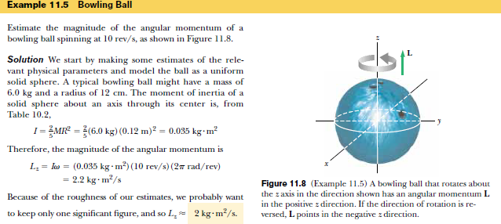

Slide 10
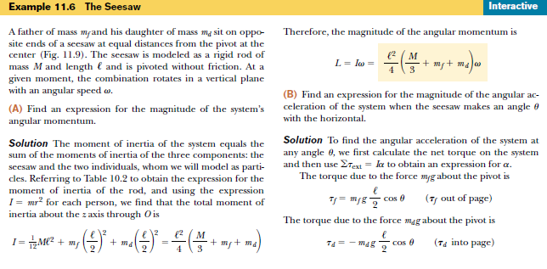

Slide 11
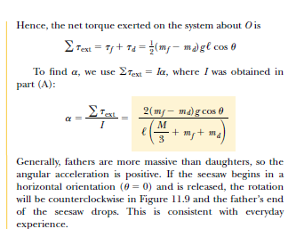
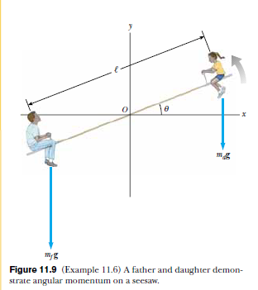

Slide 12
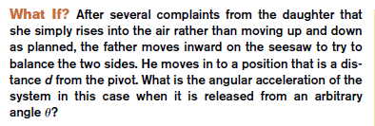

Slide 13
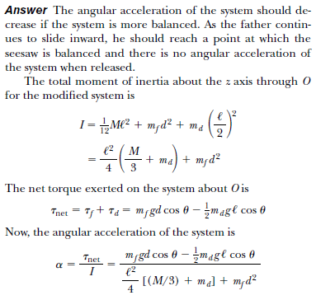
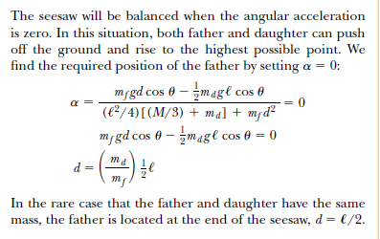

Slide 14
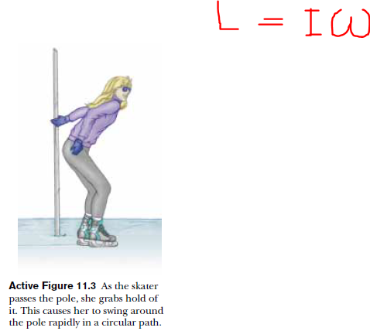

Conservation of Angular Momentum

Slide 15
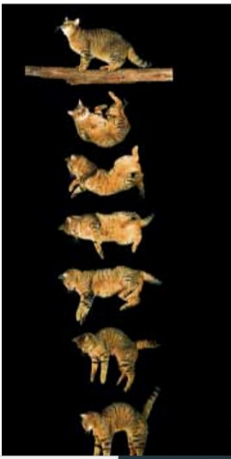

Slide 16
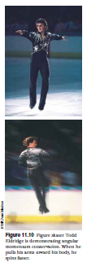
( H W) Q# 11, 12, 13, 14, 21, 22, 23, 24

